Slide 1
Health, Hope and Healing
Come on an adventure with me!

Slide 2
I’m Terry Mitchell
Let me introduce myself. I’m the Action Group Leader for West Central Association Disaster Relief
I want to introduce you to Disaster Relief

Slide 3
There are several different avenues to Disaster Relief… and we go many different places!
Hawaii
Ukraine
Louisiana
Georgia
Missouri
Guam
Kentucky
Syria
Texas
New Mexico
Turkey
Romania
Florida
All over the world!!
Check us out at https://modr.org

Slide 4
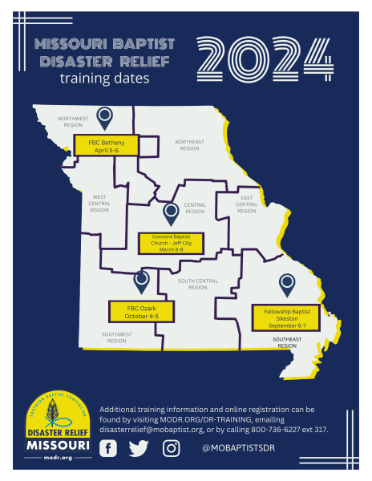
Quarterly Training Dates Yearly The more cross- training you have more valuable you are!

Slide 5
All sorts of things to be trained in…
Chaplaincy
Mass Care/Feeding
Assessment
Flood Recovery
Childcare
Communications
Shower/Laundry
Heavy Equipment Safety
Incident Management

Slide 6
The next slides show some of the work that’s been done….

Slide 7
Windstorm recovery in Waynesville

Slide 8
Delivering Hay in Texas

Slide 9
Delivering Aid in the Ukraine

Slide 10
Hope & Comfort in Hawaii

Slide 11
Typhoon Help in Guam

Slide 12
Wildfires in Hawaii

Slide 13
Turkey Earthquake Relief

Slide 14
Flood Recovery in St. Louis

Slide 15
Our main purpose is to bring the love of God to people in the midst of chaos I’d love to come and visit with you! Please contact me by phone: 816-654-3660 or email: tlmitch59@gmail.com

